Slide 1
Stelian Stoian Tema Seminar Grupa 216
Problema 9.3.4.6

Slide 2
Cerinta problemei
Utilizând metoda lui Quine simplificaţi următoarele funcţii booleene de trei variabile:
f₆$\left(x1, x2, x3\right)=$ $x2$($x1$ $∨$ $x3$) $∨$ $(\overline{x}1$↓ $x2$)

Slide 3

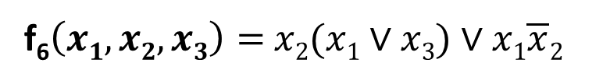
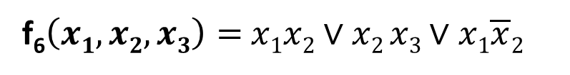
Aducerea la forma canonica disjunctiva.
f₆$\left(x1, x2, x3\right)=$ $x2$($x1$ $∨$ $x3$) $∨$ $(\overline{x}1$↓ $x2$)
f₆$\left(x1, x2, x3\right)=$ $x2$($x1$ $∨$ $x3$) $∨$ $x1\overline{x}2$
f₆$\left(x1, x2, x3\right)=$ $x1x2$ $∨$ $x2 x3$ $∨$ $x1\overline{x}2$
Completam mintermii.
f₆$\left(x1, x2, x3\right)=$ $x1x2\overline{x}3∨x1x2 x3∨\overline{x}1x2 x3∨$ $x1\overline{x}2x3∨ x1\overline{x}2\overline{x}3$

Slide 4










Determinarea mintermilor. Multimea suport.
f₆$\left(x1, x2, x3\right)=$ $x1x2\overline{x}3∨x1x2 x3∨\overline{x}1x2 x3∨$ $x1\overline{x}2x3∨ x1\overline{x}2\overline{x}3$
S_{f} = {
}
S_{f} = {(1, 0, 0), (0, 1, 1), (1, 0, 1), (1, 1, 0), (1, 1, 1)}
$$x1x2\overline{x}3$$
= m₆
(1, 1, 0)
$$\overline{x}1x2 x3$$
= m₃
$$x1x2 x3$$
= m₇
(1, 1, 1)
$$x1\overline{x}2\overline{x}3$$
= m₄
$$\overline{x}1x2 x3$$
= m₃
(0, 1, 1)
$$x1\overline{x}2x3$$
= m₅
$$x1\overline{x}2x3$$
= m₅
(1, 0, 1)
$$x1x2\overline{x}3$$
= m₆
$$x1\overline{x}2\overline{x}3$$
= m₄
(1, 0, 0)
$$x1x2 x3$$
= m₇

Slide 5


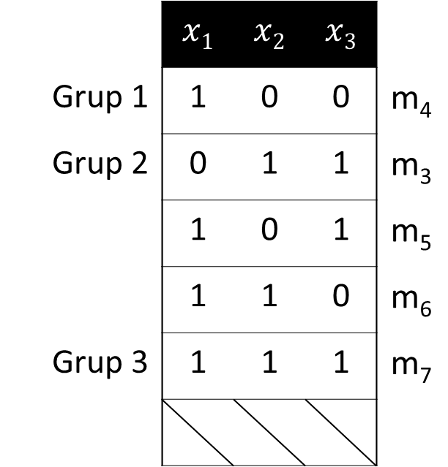



Prima tabela - Completarea
S_{f} = {(1, 0, 0), (0, 1, 1), (1, 0, 1), (1, 1, 0), (1, 1, 1)}
$$\overline{x}1x2 x3$$
= m₃
$$x1\overline{x}2\overline{x}3$$
= m₄
 | $$x1$$ | $$x2$$ | $$x3$$
Grup 1 | 1 | 0 | 0 | m₄
Grup 2 | 0 | 1 | 1 | m₃
 | 1 | 0 | 1 | m₅
 | 1 | 1 | 0 | m₆
Grup 3 | 1 | 1 | 1 | m₇
$$x1\overline{x}2x3$$
= m₅
$$x1x2\overline{x}3$$
= m₆
$$x1x2 x3$$
= m₇

Slide 6
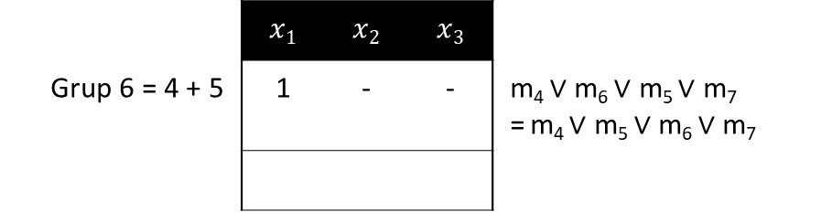
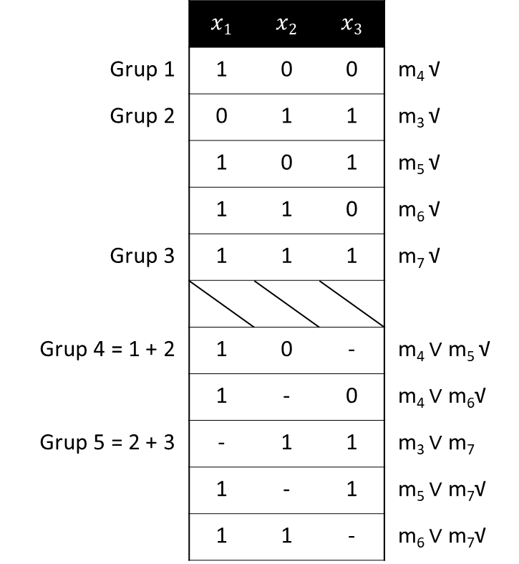
Prima tabela - Factorizarea
 | $$x1$$ | $$x2$$ | $$x3$$
Grup 1 | 1 | 0 | 0 | m₄ √
Grup 2 | 0 | 1 | 1 | m₃ √
 | 1 | 0 | 1 | m₅ √
 | 1 | 1 | 0 | m₆ √
Grup 3 | 1 | 1 | 1 | m₇ √
Grup 4 = 1 + 2 | 1 | 0 | - | m₄ $∨$ m₅ √
 | 1 | - | 0 | m₄ $∨$ m₆√
Grup 5 = 2 + 3 | - | 1 | 1 | m₃ $∨$ m₇
 | 1 | - | 1 | m₅ $∨$ m₇√
 | 1 | 1 | - | m₆ $∨$ m₇√
 | $$x1$$ | $$x2$$ | $$x3$$
Grup 6 = 4 + 5 | 1 | - | - | m₄ $∨$ m₆ $∨$ m₅ $∨$ m₇ = m₄ $∨$ m₅ $∨$ m₆ $∨$ m₇

Slide 7
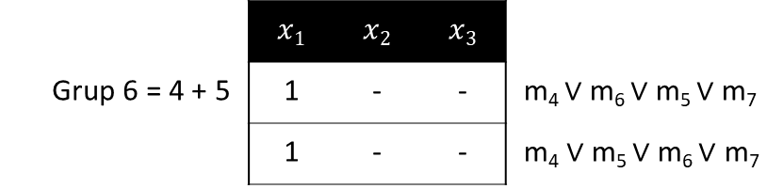

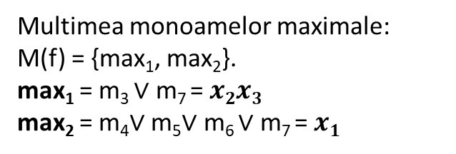
Prima tabela - Factorizarea
 | $$x1$$ | $$x2$$ | $$x3$$
Grup 1 | 1 | 0 | 0 | m₄ √
Grup 2 | 0 | 1 | 1 | m₃ √
 | 1 | 0 | 1 | m₅ √
 | 1 | 1 | 0 | m₆ √
Grup 3 | 1 | 1 | 1 | m₇ √
Grup 4 = 1 + 2 | 1 | 0 | - | $\text{m}\text{4}∨$m₅ √
 | 1 | - | 0 | m₄ $∨$ m₆ √
Grupa 5 = 2 + 3 | - | 1 | 1 | m₃ $∨$ m₇
 | 1 | - | 1 | m₅ $∨$ m₇ √
 | 1 | 1 | - | m₆ $∨$ m₇ √
 | $$x1$$ | $$x2$$ | $$x3$$
Grup 6 = 4 + 5 | 1 | - | - | m₄ $∨$ m₆ $∨$m₅ $∨$ m₇
 | 1 | - | - | $\text{m}\text{4}∨$m₅ $∨$ m₆ $∨$ m₇
Multimea monoamelor maximale:
M(f) = {max₁, max₂}.
max₁ = m₃ $∨$ m₇ = $x2x3$
max₂ = m₄$∨$m₅$∨$ m₆ $∨$ m₇ = $x1$

Slide 8
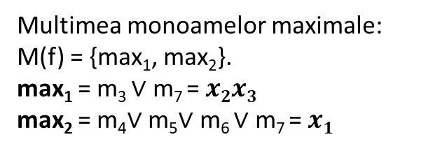
Monoamele centrale
S_{f} = {(1, 0, 0), (0, 1, 1), (1, 0, 1), (1, 1, 0), (1, 1, 1)}
$$\overline{x}1x2 x3$$
= m₃
$$x1\overline{x}2\overline{x}3$$
= m₄
$$x1\overline{x}2x3$$
= m₅
Mintermi \ Monoame maximale | max₁ | max₂
m₃ | *
m₄ |  | *
m₅ |  | *
m₆ |  | *
m₇ | * | *
$$x1x2\overline{x}3$$
= m₆
$$x1x2 x3$$
= m₇
Multimea monoamelor maximale:
M(f) = {max₁, max₂}.
max₁ = m₃ $∨$ m₇ = $x2x3$
max₂ = m₄$∨$m₅$∨$ m₆ $∨$ m₇ = $x1$
Avem C(f) =
{max₁, max₂}.

Slide 9
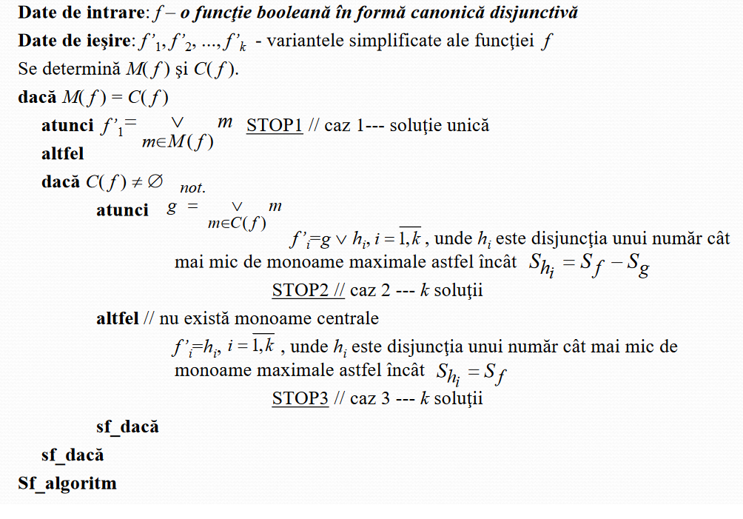
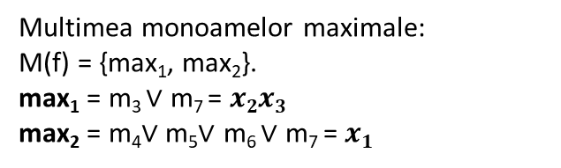

Algoritmul de simplificare.
M(f₆) = C(f₆) = {max₁, max₂}
Suntem in cazul .
1
Avem forma simplificata
f$′\left(x1, x2, x3\right)$ = max₁ $∨$ max₂ = $x1$ $∨$ $x2x3$
Multimea monoamelor maximale:
M(f) = {max₁, max₂}.
max₁ = m₃ $∨$ m₇ = $x2x3$
max₂ = m₄$∨$m₅$∨$ m₆ $∨$ m₇ = $x1$

Slide 10
Final
8D

